Slide 1
Employee data analysis

Slide 2
Project Overview
This project aimed to analyze the hiring process of a multinational company using historical recruitment data to identify key patterns and inefficiencies. The analysis focused on understanding trends in rejections, interviews, job types, and vacancies.
Key steps included:
Data Cleaning: Identified and handled missing values to ensure accuracy.
Category Simplification: Clubbed similar job titles and rejection reasons to streamline analysis.
Outlier Detection and Treatment: Used statistical techniques (like IQR and box plots) to flag and remove skewed data points.
Data Summary: Calculated key metrics such as average time-to-hire, rejection rates, and most common job types. Created visualizations like bar charts and pie graphs for better insights.

Slide 3
Key Insights:
High rejection rate (around 60%) mostly due to skill gaps.
Interview rounds exceeding 5 tend to have lower success rates.
Software Engineering roles were most frequently hired.
Average time-to-hire was around 45 days.

Slide 4
Data Quality
Outliers found are 3 replaced by the mean of the offered salary
There are 17 empty cells, where 15 are found in the event column,1 found in postname, and 1 found in the offered salary
mean of the offered salary :
median of offered salary
mode of offered salary
49878
49625
49878.3318

Slide 5
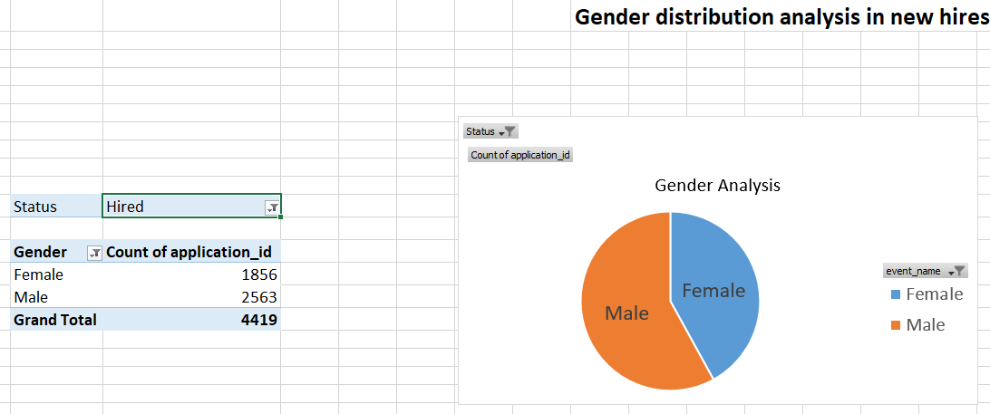
Gender Analysis in new hiring
It can be seen that more employees which are hired are males so can increase the hiring of females to promote equality

Slide 6
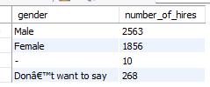
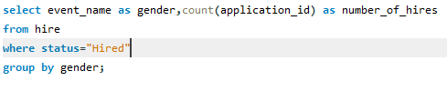
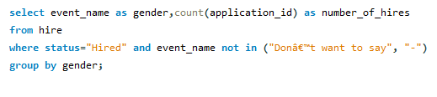

SQL QUERY

Slide 7
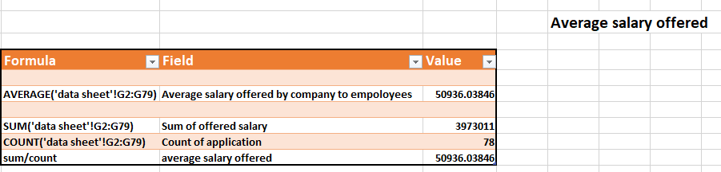
Salary Analysis
Average salary which is offered is 50936

Slide 8

SQL query

Slide 9
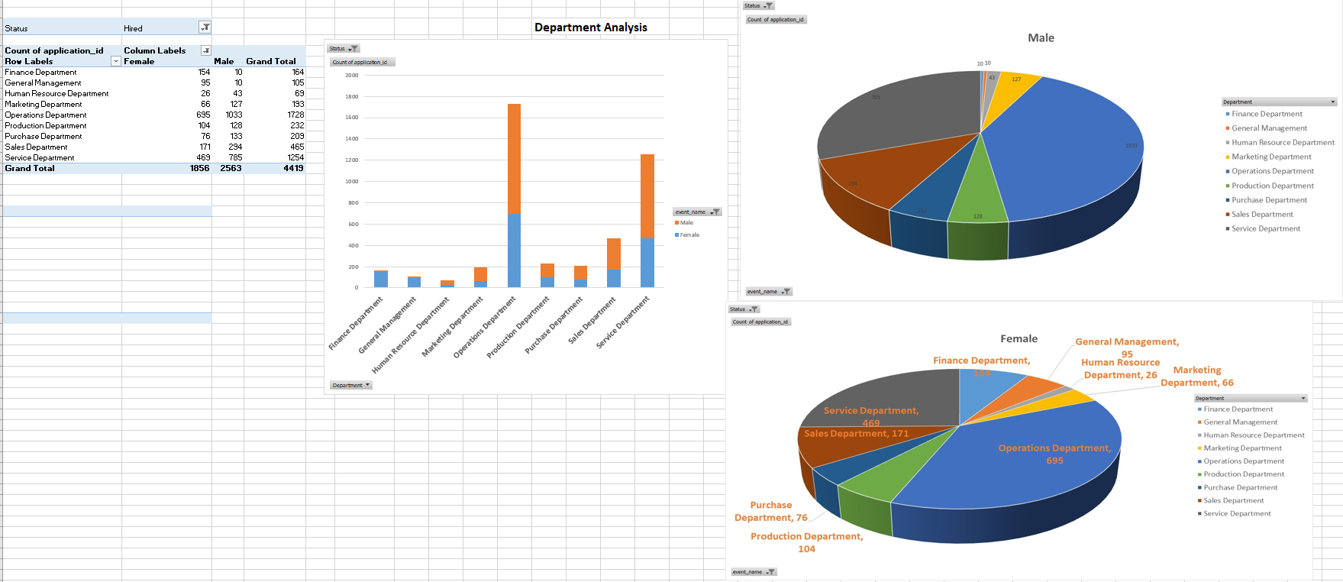
Department analysis

Slide 10
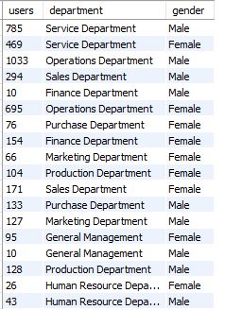

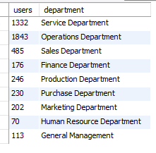

SQL query
Most of the hirings are done in operations department in which proportion of males are more

Slide 11
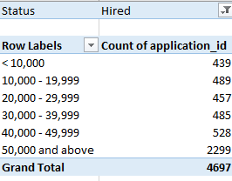
Salary distribution
Most of the employees hired are offered salary more than 50,000 more than average salary

Slide 12
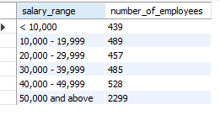
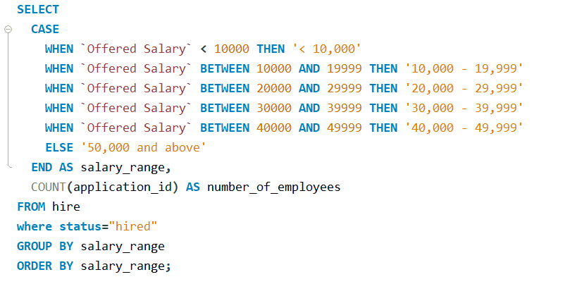
SQL Query

Slide 13
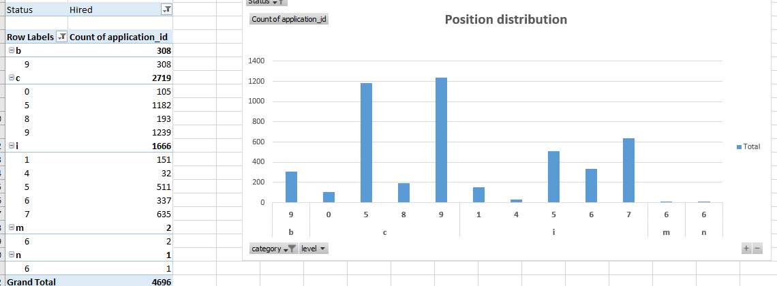
Position tier analysis
Most employees hired are posted in level c and tier 9 which is c9 and least in n so company resources can be distributed accordingly

Slide 14
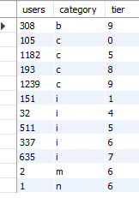
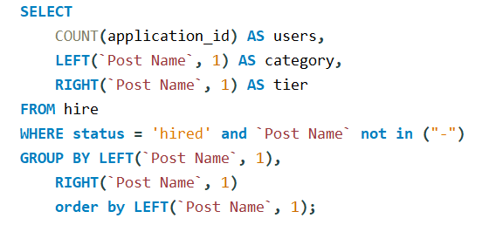
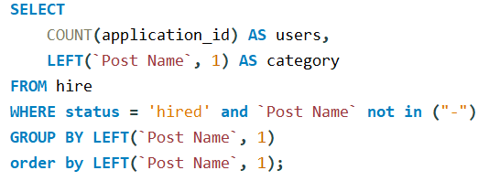
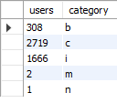
SQL Query

Slide 15
Excel workbook
https://docs.google.com/spreadsheets/d/1-4HG0paPFuUyVyoMY74TkqnQw2ELndGi/edit?usp=sharing&ouid=107863361805641426587&rtpof=true&sd=true

Slide 16
Recommendations
Streamline Interview Rounds: Roles requiring more than 6 rounds showed a lower success rate. Optimize the process to a max of 5 rounds.
Skill Development Programs: Address the largest rejection factor – “Skill Gap” – by partnering with online education platforms.
Data Input Validation: Prevent future outliers by enforcing validation rules during data entry.
Focus on High-Conversion Roles: Allocate more hiring resources to roles with high conversion rates and faster turnaround.

